Slide 1


CMR TECHNiCAL CAMPUS UGC AUTONOMOUS Accredited by NBA & NAAC with A Grade Approved by AICTE, New Delhi and Affiliated to JNTU, Hyderabad
DEPARTMENT OF COMPUTER SCIENCE AND ENGINEERING
MINI-PROJECT REVIEW
ON
AUTOMATED MEDICINE REPOSITORY
PRESENTED BY
ARUN DEEPAK AKUNURI
197R1A05J2
CSE-D-IV YEAR

Slide 2
CONTENTS
Introduction
Abstract
Existing System
Disadvantages
Proposed System
Advantages
Novelty of the System
Conclusion

Slide 3
Introduction
The Project Aims to improve self-dependent health care for patients who need to depend on themselves for their daily health needs.
With many patients and householders taking regular medicine which doesn’t require any formal prescription, this solution will be helpful to those people

Slide 4
Abstract
At all times many of us fall sick or at some point in our life we do require medication. Many of us buy medicines from various pharmacists based on our doctor’s prescription. Every medicine is always manufactured with an expiry date on it. Most of us because of human tendency we often forget the medicines lying in our rack and since we generally have the “out of sight -out of mind” feature, we forget.
During any emergency situation, in case of a medical emergency and we don’t have the right medicine for the problem or if the patient consumes an expired medicine or if the patient has been given an overdose of a particular medicine when the medicine dosage is meant for moderation it can cause serious problems.

Slide 5
Existing System
The existing system is in built with a hospital patient record. Patients with special physical care and needs are isolated from the others and special team is always there to take care of them. Often due to work the team might not be able to provide full time care to patient. Patients who speak different languages apart from the caretakers because of which it is hard to enable proper relationship.
Some patients might not be able to get admitted to hospital due to various reasons. In that case treatment at home becomes the need of the hour. To be able to connect with doctors and also be self-reliant and self-dependent without having to exert themselves physically the current system could not offer.

Slide 6
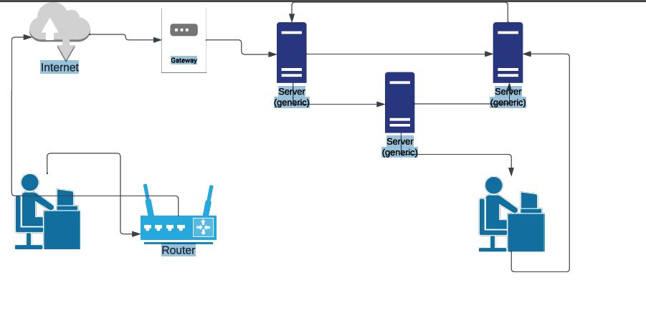
Existing System Architecture

Slide 7
Disadvantages
Lack of Automation makes it prone to errors
The entire system acts as a single point of failure.
No risk mitigation
Insecure Gateway

Slide 8
Proposed System
We Propose a Smart Medicine Management System wherein patients can have their data stored and it give real time monitoring alerts about the medicines and alert them when to take medicines and the prescribed number of doses. The system maintains a real time data on what the patient is prescribed and how the doses are scheduled.
The system also contains the expiry date of each medicine which is used on a general term such as Benadryl, Dolo 650, Paracetamol etc. The Medicines details are also updated on the system in real time making it efficient to use.

Slide 9
Hardware Requirement
Processor : Pentium IV or Higher
RAM : 256 MB
Internet Connection
Hard Disk : 512 MB (Minimum)

Slide 10
Software Requirement
Python
HTML
Java-Script
Word-press Hosting
HIPPA Compliance Document – AWS Artifacts
AWS Aurora
AWS Cloud-Formation- Web Template.
AWS Lambda

Slide 11
Novelty
The approached solution has several improvements for the current healthcare technologies. Firstly, patients who rely upon caretaking, their entire experience can be improved. This project uses AWS Cloud Computing infrastructure which has a very good reliability and scalability. The SLA (service level agreement) offered by AWS is 99.99% for a standard service tier. With multiple offerings within AWS Marketplace, it’s easy to develop and deploy a cloud-native solution aiming to improve healthcare for patients.

Slide 12
Components
AWS SNS
HTML Page
SNS API For HTML Page
AWS Lambda
AWS Cloud-Formation

Slide 13
AWS SNS
Amazon Simple Notification Service (Amazon SNS) is a fully managed messaging service for both application-to-application (A2A) and application-to-person (A2P) communication.
The A2A pub/sub functionality provides topics for high-throughput, push-based, many-to-many messaging between distributed systems, micro-services, and event-driven server-less applications. Using Amazon SNS topics, your publisher systems can fan-out messages to a large number of subscriber systems, including Amazon SQS queues, AWS Lambda functions, HTTPS endpoints, and Amazon Kinesis Data Firehose, for parallel processing.

Slide 14
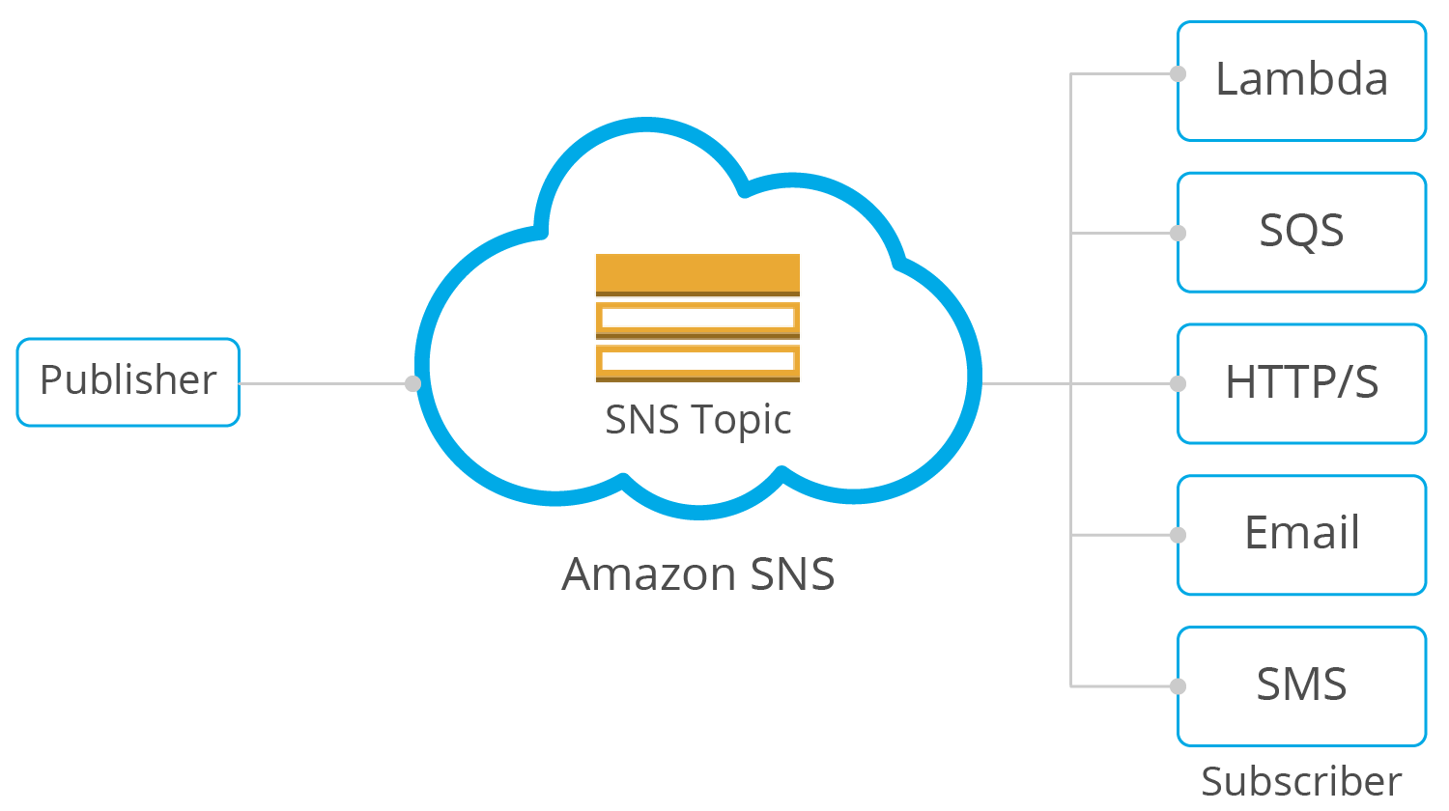
AWS SNS

Slide 15
AWS Cloud-Formation
AWS CloudFormation is a service that helps you model and set up your AWS resources so that you can spend less time managing those resources and more time focusing on your applications that run in AWS. You create a template that describes all the AWS resources that you want (like Amazon EC2 instances or Amazon RDS DB instances), and CloudFormation takes care of provisioning and configuring those resources for you.

Slide 16
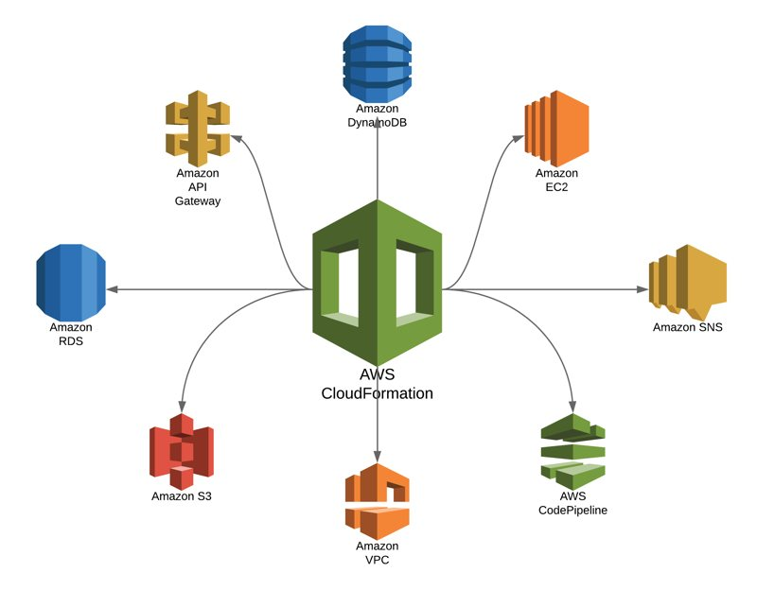
Cloud Formation – Standard Template

Slide 17
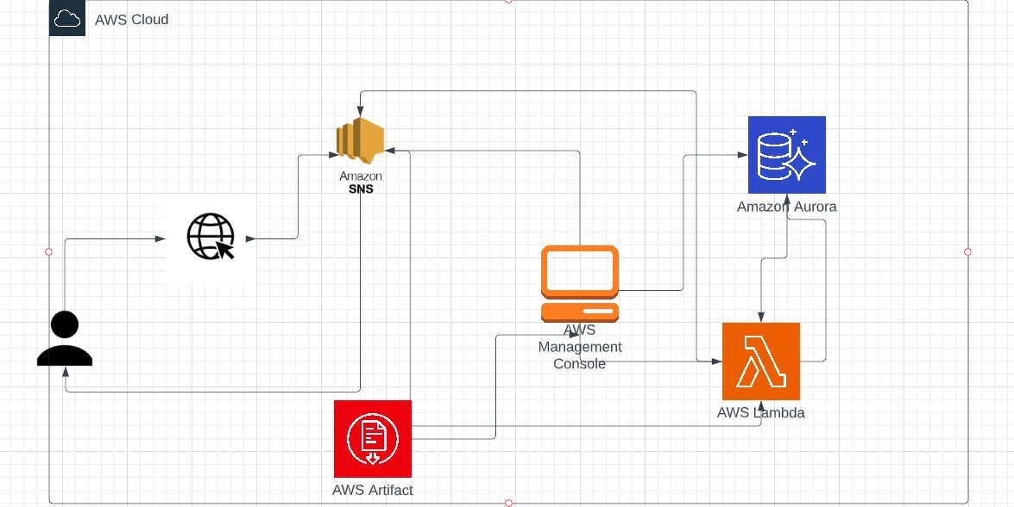
Solution Architecture

Slide 18
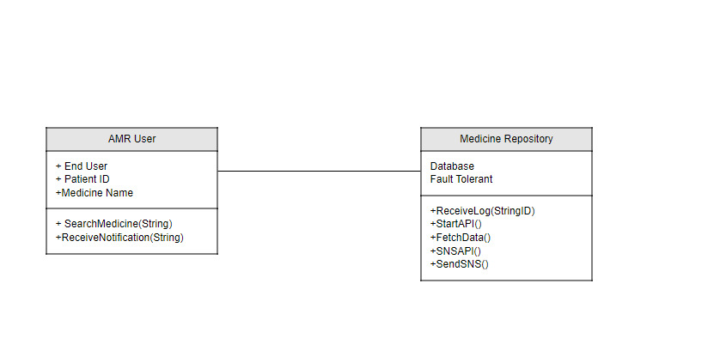
Class Diagram

Slide 19
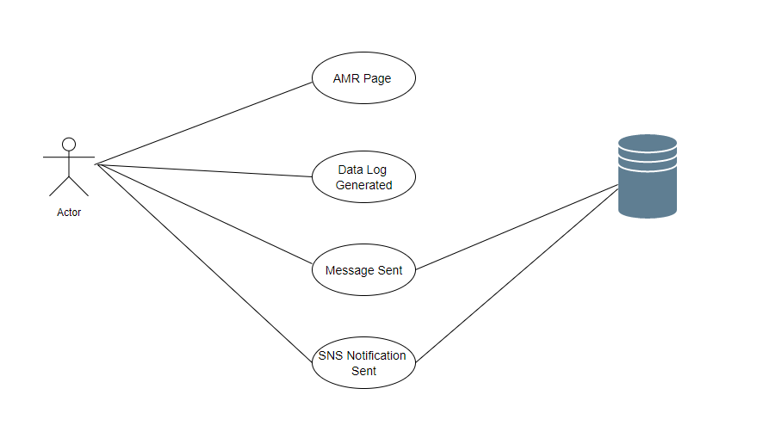
Use Case Diagram

Slide 20
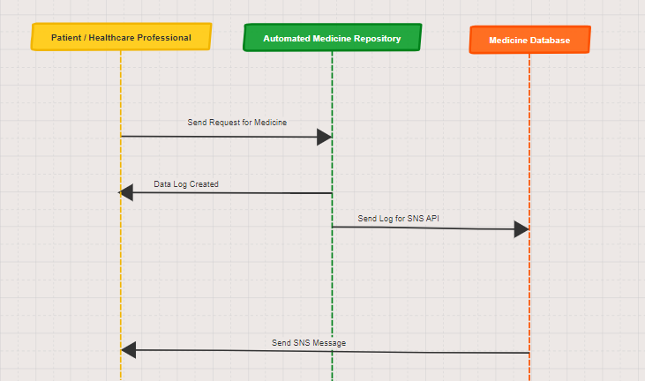
Sequence Diagram

Slide 21
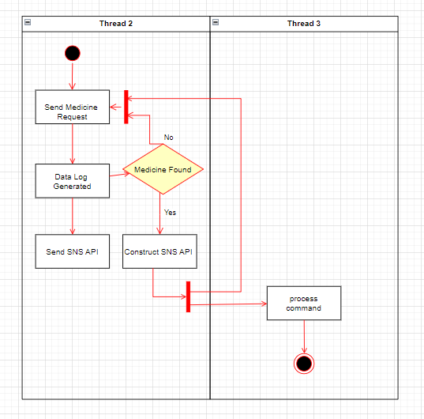
Activity Diagram

Slide 22
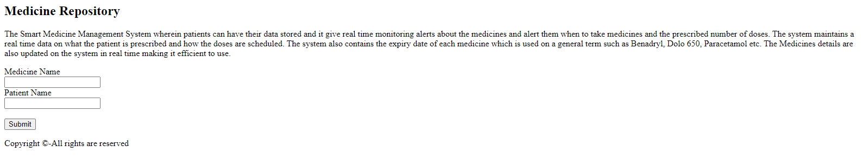
Results Main Page
The main page consists of form which can be used to enter information to the server.
The main Page Consists of Information of the project

Slide 23
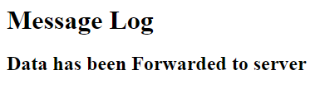
Message Log Page

Slide 24
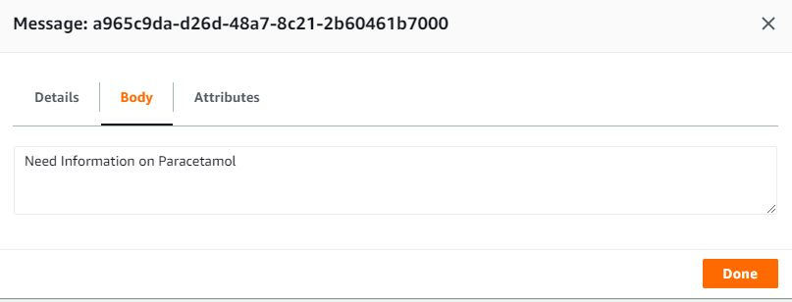
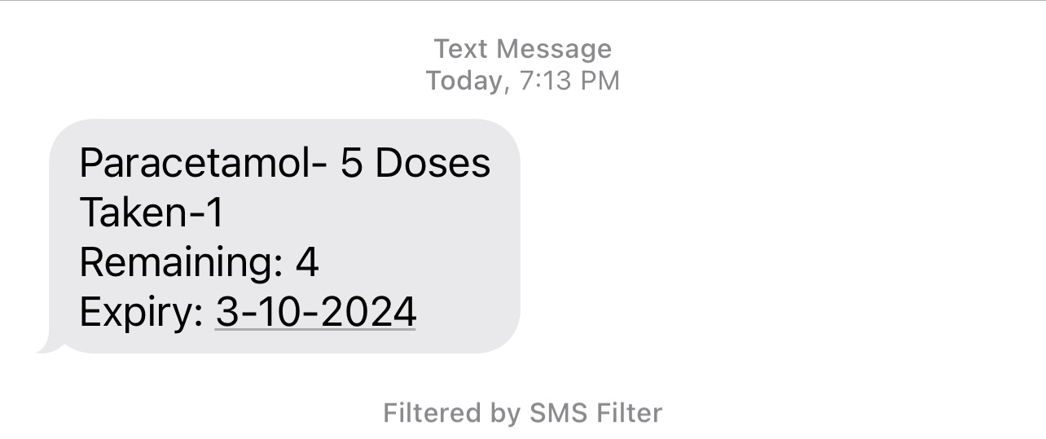
System Output

Slide 25
Conclusion
This project focuses on providing a real-time medicine management and an innovative way of taking care of all medicines in a household or a hospital. This system can be deployed anywhere and using cloud it makes it quite easier to understand, deploy and manage. Since cloud based application can be used without any downtime it is easy to rely upon during emergency situations.

Slide 26
THANK YOU
197R1A05J2

